Slide 1

Open the Doors to inclusive housing
Your name/organization
Council you are presenting to
Date

Slide 2
Open the door to inclusive housing in BC
Over 5,000 adults in BC with developmental disabilities are looking for homes of their own. Inclusive housing means having access to the same choices about where you live as everyone else. It’s the key to independence, stability and belonging.
Learn how you can open the door to inclusive housing in your community.

Slide 3
What is inclusive housing?
It’s housing that is affordable, close to community amenities, physically accessible and most importantly welcoming of people of all abilities, including those with developmental disabilities.

Slide 4
Benefits of Inclusive Housing
Housing developments should reflect their communities and the demographics of the population.
Welcoming neighbourhoods, towns and cities all benefit from inclusion. The movement to empower and include people with developmental disabilities in our communities is called community living.
Examples of the benefits of inclusion abound, for example:
writing and speaking in plain language benefits people who have English as a second language;
accessibility for people who use wheelchairs benefits parents pushing strollers and travellers pulling suitcases;
inclusive employment produces more positive and productive workplaces.

Slide 5

Affordable
What it looks like
Welcoming and community facing
Successful inclusive housing offers people with developmental disabilities choice in where they live and who they live with. It fosters relationships among people and vibrant community life. It promotes safety and allows individuals to experience life in a neighbourhood. Usually it looks like housing for most other people and needs to be:
Close to community amenities
Accessible

Slide 6
Elements of Inclusive Housing
Choice
Accessibility
Ratio
Diversity
Sustainability
Choice and control over living space is fundamental to the concept of home and to quality of life.

Slide 7
Elements of Inclusive Housing
Choice
Accessibility
Ratio
Diversity
Sustainability
Housing must meet basic requirements that give people access to both their homes and to their community.

Slide 8
Elements of Inclusive Housing
Choice
Accessibility
Ratio
Diversity
Sustainability
Ratio of people with and without disabilities: Inclusion is not defined by a hard ratio and is dependent on the size of the development, the neighbourhood it is located in, and how opportunities for inclusion are built in and created.

Slide 9
Elements of Inclusive Housing
Choice
Accessibility
Ratio
Diversity
Sustainability
Housing reflects the diversity of the community. Individuals have a wide range of backgrounds, interests, preferences, and support needs.

Slide 10
Elements of Inclusive Housing
Choice
Accessibility
Ratio
Diversity
Sustainability
Housing needs to provide stability and a sense of permanency to individuals and be amenable to supports being provided in a quality and cost-effective manner.

Slide 11
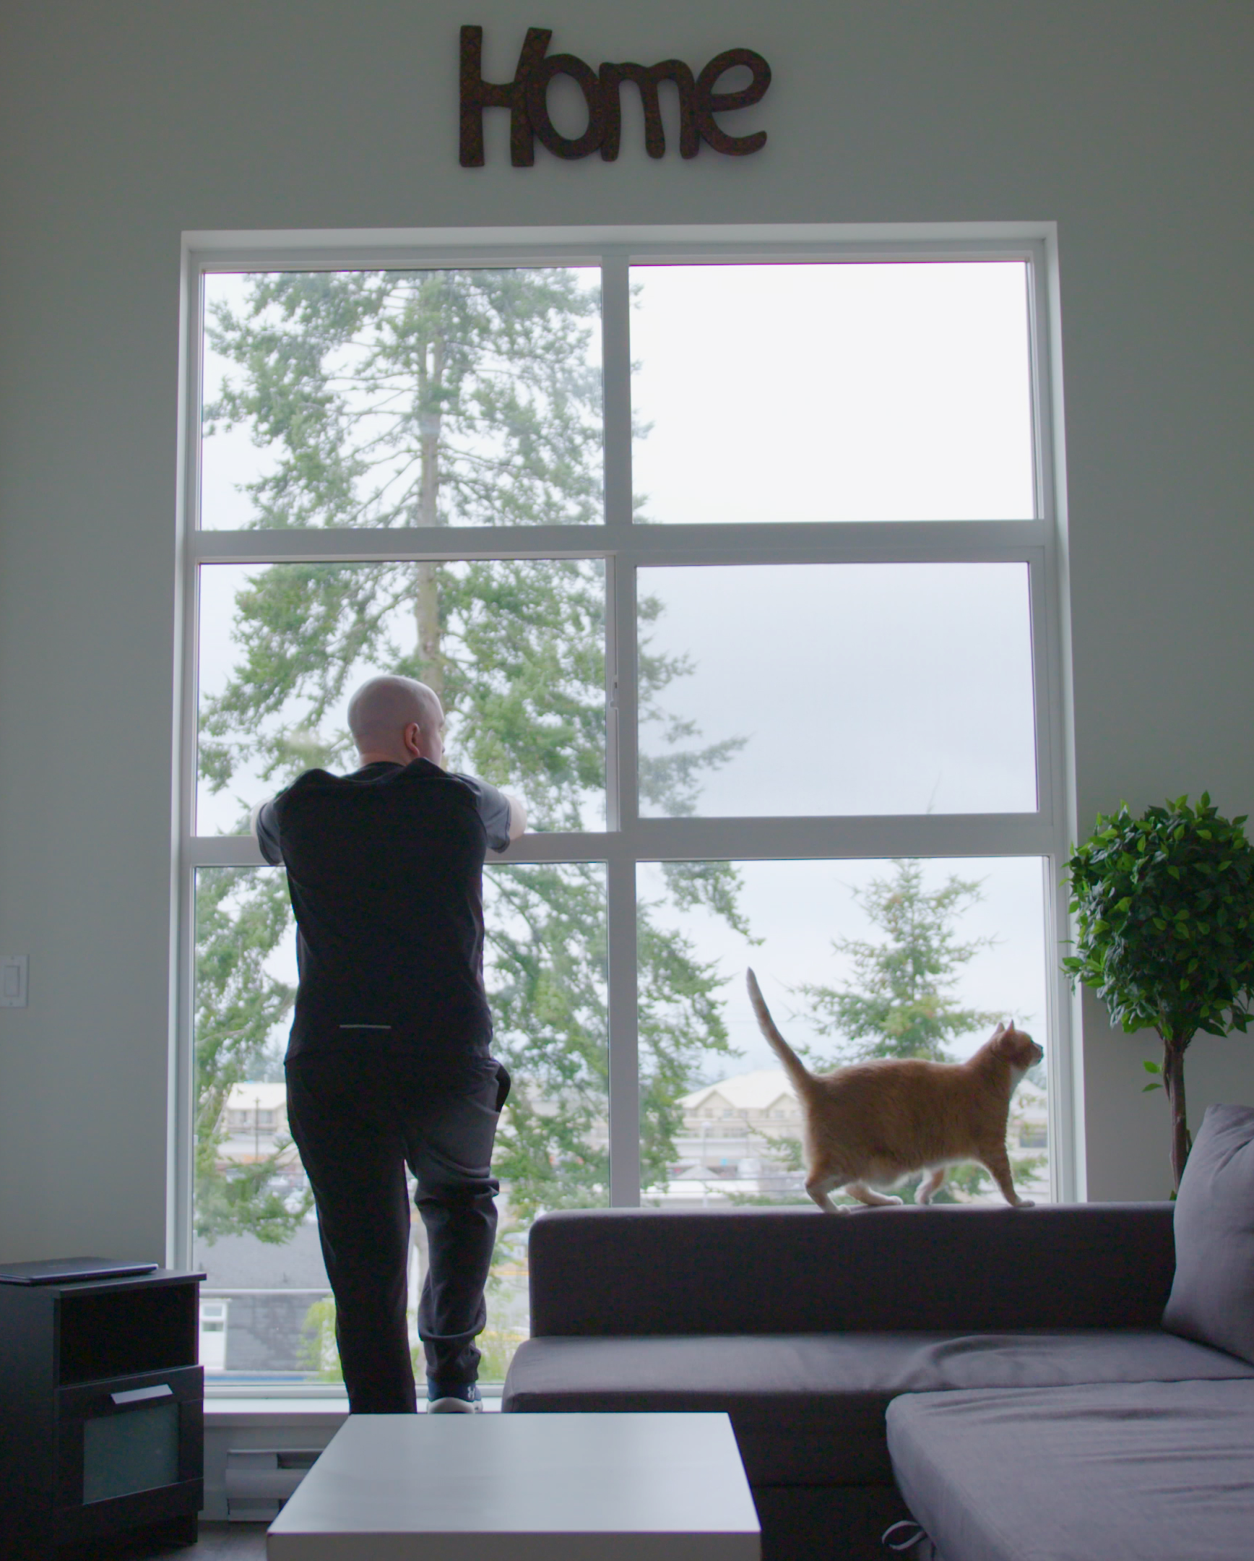
Our inclusive housing stories
Impact
Notes:
Here you can tell the story of the needs/opportunities of your local community.

Slide 12
Role of Local Governments
Inclusive housing requires a combination of land or existing buildings, money, vision, understanding, planning design and building expertise, appropriate zoning, and perhaps paid supports for individuals who live there. No one agency or family has all of those resources.
Municipal government can be an ally and enabler of inclusive housing projects through:
Land-use planning and zoning
Land you could donate, lease or sell
Supporting projects through measures such as tax exemptions, waiving development permit costs and fast-tracking applications
Grants or other ways to support affordable housing
Encouraging partnerships.

Slide 13
Other Community Partners
Increasing availability of inclusive housing for people with developmental disabilities is a priority for Inclusion BC and its members and for Community Living BC (CLBC) and its stakeholders.
No one player has all the expertise and capacity to make inclusive housing happen alone.
Collaborations among people and organizations with experience in community living, housing, financing and planning are the way to go.
Inclusive housing requires the understanding and participation of partners including housing providers, developers, municipal planners and many more.
CLBC funds supports for people with developmental disabilities to live, work and participate in their community. However, its mandate does not include creating housing. So we need to help others understand the benefits to our communities of creating affordable and inclusive housing options for those CLBC serves. Learn more at communityliving.bc.ca/InclusiveHousing.

Slide 14

Key to Home video
Notes:
Click the preview image to play the embedded video.

Slide 15
Thank you
Questions?

